Slide 1
Central Surgery – Journey to Demand-led Access

Slide 2
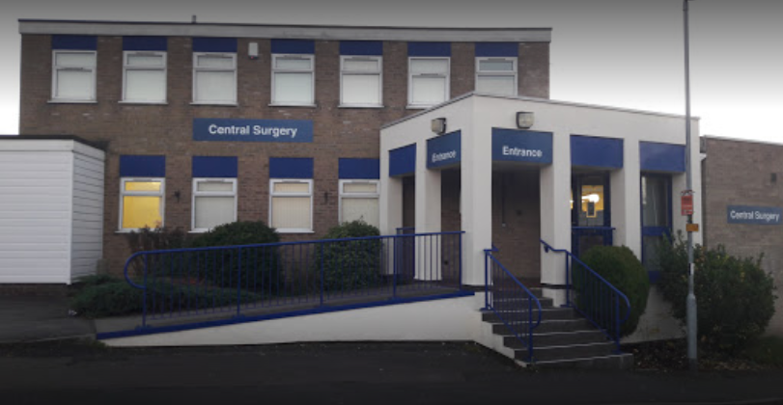
Central Surgery

Slide 3
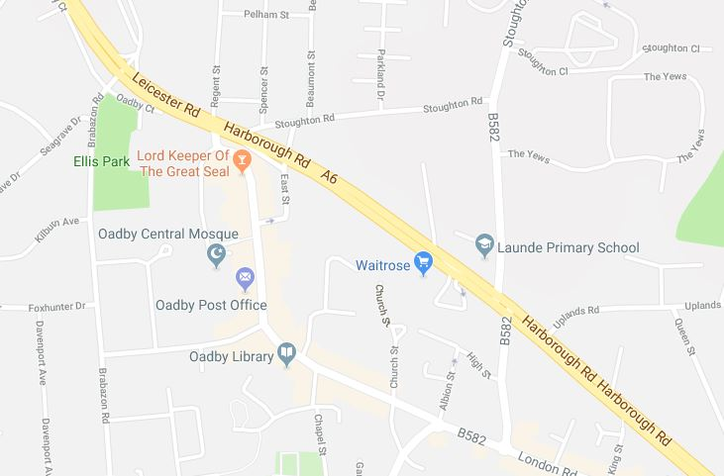
Central Surgery
8700 patients
6 GP Partners, 4.1 WTE
Support clinical team
1 salaried GP, 1 ANP, 1 paramedic, 1 pharmacist, 2 nurses
Oadby WIC
Central Surgery

Slide 4
Central Surgery
At Central Surgery our mission is to provide excellent, compassionate, personalised NHS care for our community
We also believe that General Practice delivers the highest quality Primary Care for our patients

Slide 5
Previous access model
GP and minor illness clinician appointments offered each day. Booked by reception or online
GP appts are a mix of on-the-day and prebookable, both face to face and telephone
Minor illness clinicians are on-the-day face to face appointments only
On-call GP for urgent problems

Slide 6
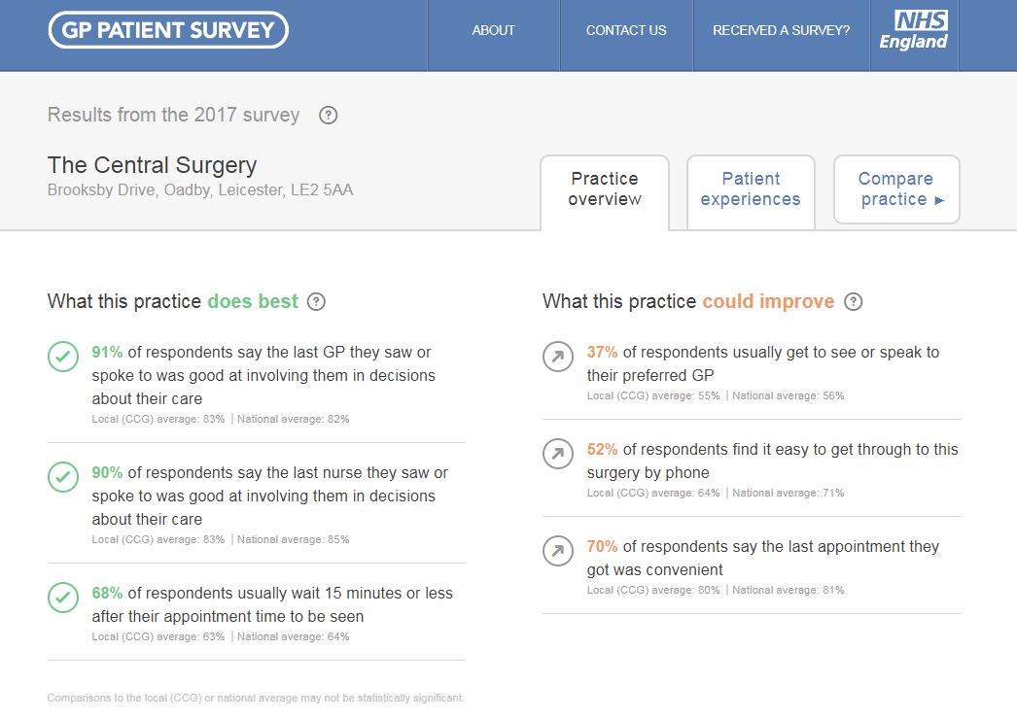
Why change access?

Slide 7
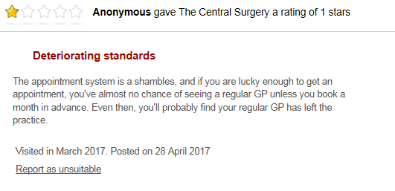
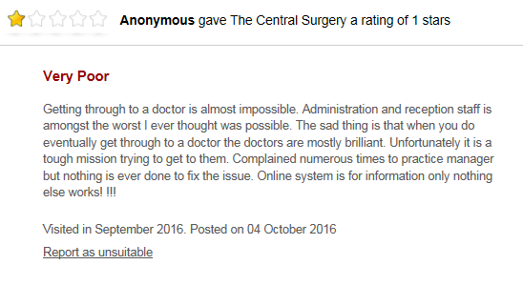
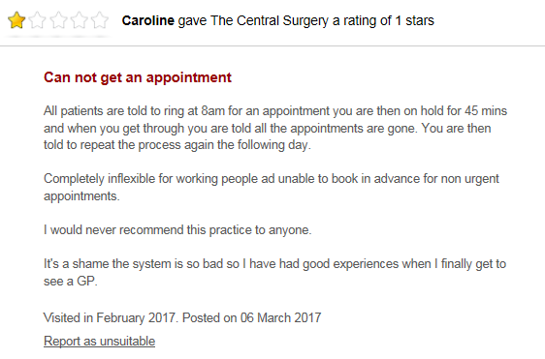
Why change access?

Slide 8
Issues with previous access model
Multiple ways to access system creates confusion
Relies on the patient to know whether they need a GP or minor illness
Finite number of appointments quickly become saturated - ‘Call back at 8am tomorrow’
Patient and clinician anxiety that cannot get appointment
Increasing patient frustration and unmet demand
Increasing Walk In Centre / A&E usage

Slide 9
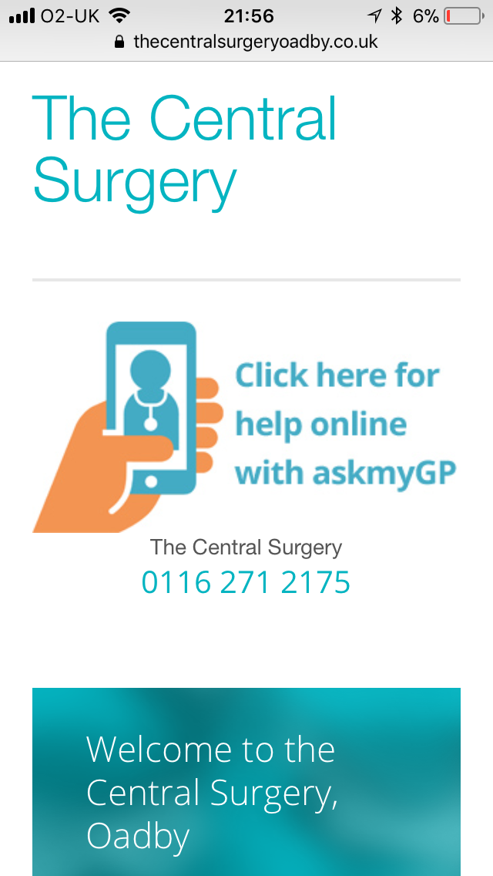
Demand led access model
One simple way to access service
Patients advised to email or call in on the day that they need help, rather than pre-book
Patients will be triaged by preferred GP or clinician, usually within 1 hour
If patient needs appointment they will be offered one on the same day
Surgery is never ‘full’ so no patient turned away

Slide 10
Implementing Demand Led access
In order to deliver Demand-led access successfully, the full patient demand needs to be understood and the service adapted to meet it
Patient demand for each day and each week can be reliably predicted

Slide 11
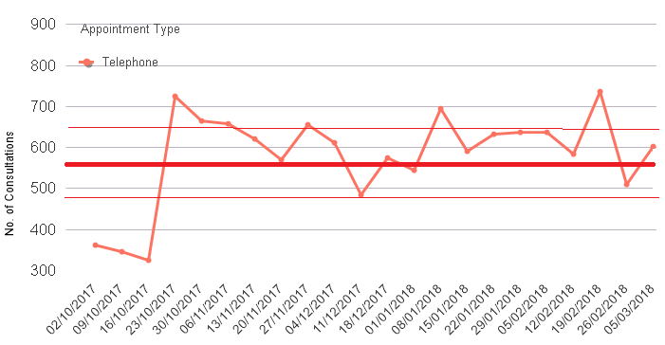
Implementing Demand Led access
At start of project we projected to receive 570 patient contacts per week +/- 15% tolerance.
Demand since askmyGP launch
+15%
Projected demand
-15%

Slide 12
Implementing Demand Led access
The level of demand varies per day of the week and does so predictably
Once demand is understood, the service can be adapted accordingly
 | Predicted demand distribution | Actual demand distribution Feb 18
Monday | 28% | 28.2%
Tuesday | 21% | 20.2%
Wednesday | 18% | 17.3%
Thursday | 16% | 15.3%
Friday | 17% | 18.8%

Slide 13
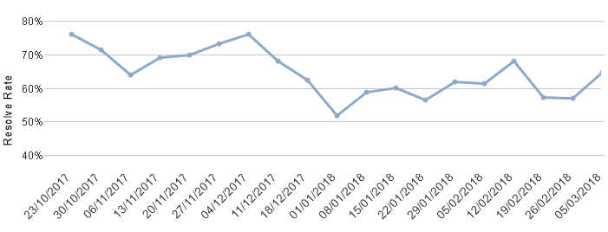
Implementing Demand Led access
Senior clinical triage of each patient request allows them to be managed efficiently and effectively
The majority of patient requests don’t require a face to face appointment
‘Resolve rate’ since askmyGP launch

Slide 14
Implementing Demand Led access
Patient requests can be managed quickly allowing delivery of an efficient service
Response time since askmyGP launch

Slide 15
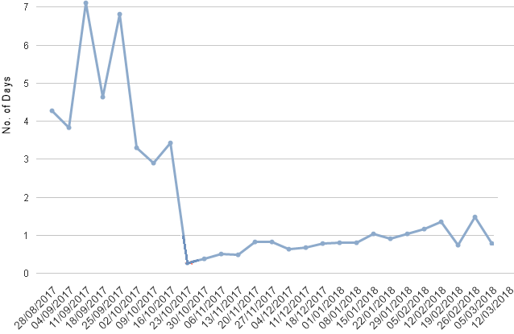
Implementing Demand Led access
Patient requests can be managed quickly allowing delivery of an efficient service
Waiting time for GP appointment
since askmyGP launch

Slide 16
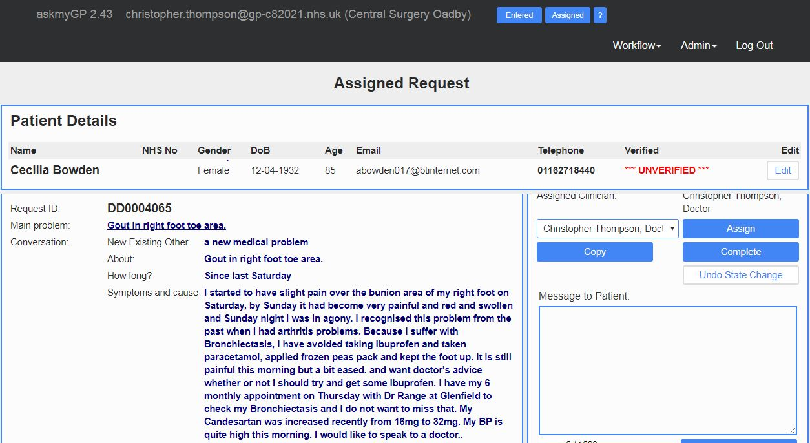
Implementing Demand Led access
Secure online communication improves efficiency and is convenient for patients

Slide 17
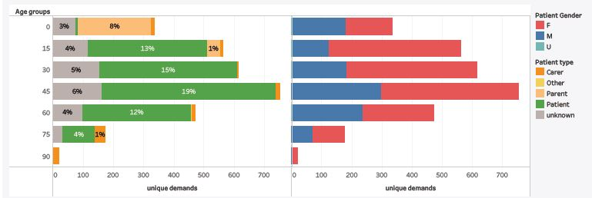
Implementing Demand Led access
Online communication is not just for the young!
Parents / carers can also log requests
Patient contacts for askmyGP 4th Feb – 4th March 2018

Slide 18
Impact of Demand Led Access
For Central Surgery patients
Significant improvement in patient access
Increased patient satisfaction, evidenced by feedback
For wider health community
Significant reduction in In-Hours Walk In Centre usage and reduction in Out of Hours Walk In Centre usage
Modest reduction in In-Hours A&E usage

Slide 19
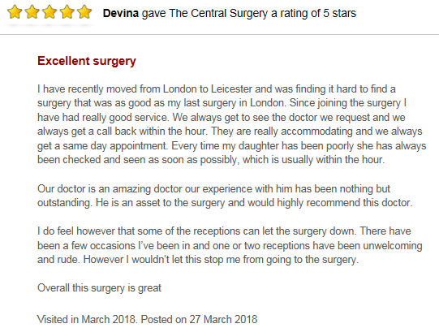
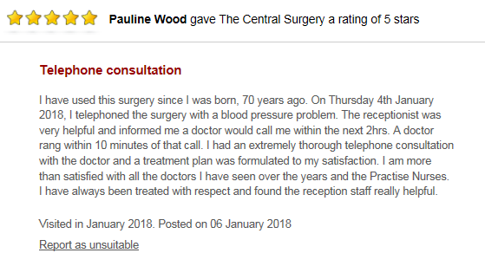
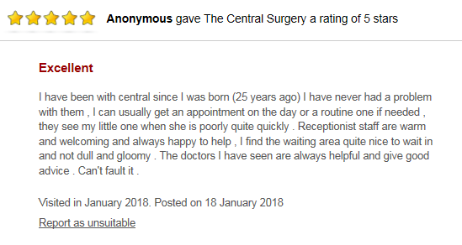
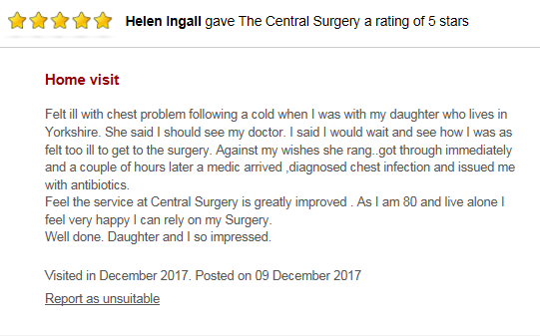
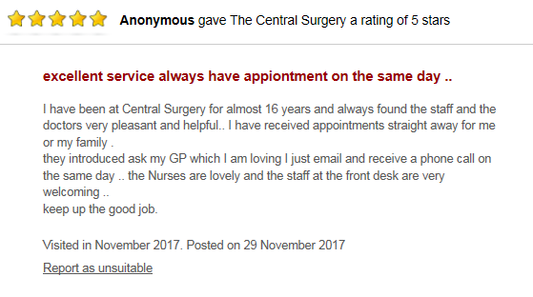
Impact of Demand Led Access

Slide 20
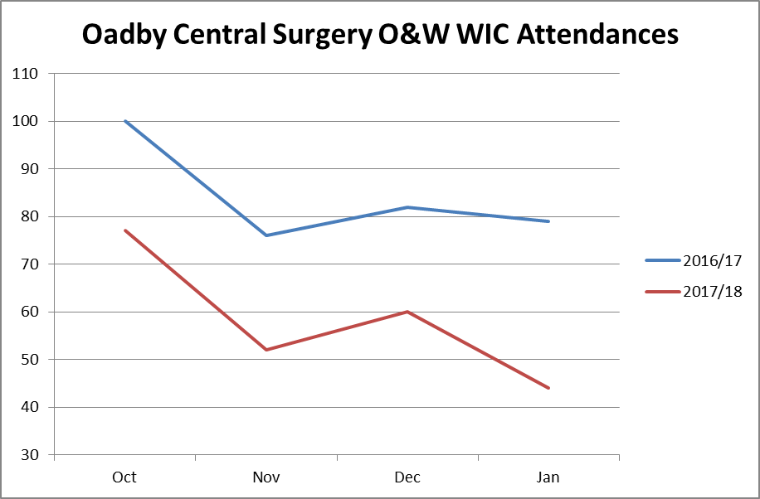
Impact of Demand Led Access
For wider health community
Significant reduction in In-Hours Walk In Centre Attendance

Slide 21
Impact of Demand Led Access
Reduction in A&E and WIC usage exceeds local trend
 | Central Surgery |  |  | O&W Locality (minus Central)
 | Nov – Jan 16/17 | Nov – Jan 17/18 | % Change | Nov – Jan 16/17 | Nov – Jan 17/18 | % Change
In Hours Oadby Walk-In | 337 | 233 | -30.9% | 1915 | 1629 | -14.9%
Out of Hours Oadby Walk-In | 322 | 309 | -4% | 1677 | 1614 | -3.8%
In Hours A&E | 310 | 298 | -3.9% | 1955 | 1956 | +0.1%
Out of Hours A&E | 349 | 373 | +6.9% | 2198 | 2294 | +4.4%

Slide 22
Impact of Demand Led Access
‘I can honestly say, in my 20-odd year career in NHS Informatics, I have never been so impressed by the transformation delivered by an IT-lead intervention in any GP practice, and I have visited hundreds over the years.
I am in no doubt that this has happened because of the whole-team approach to transformation taken by the practice, which is a credit to the leadership shown and participation of everyone at the surgery.
Not only do I think this is an exemplar of good practice in the local area, I firmly believe that what you are doing is significant on a national scale as a demonstration of how general practice can respond to the challenge of ever-increasing demand on services.’
Alan Oliver
Project Manager HIS
for Online Consultations

Slide 23
Key Learning Points for O&W Acute Access
Services need to fully understand total patient demand and adapt their clinical supply to meet it
Experienced clinician triage reduces unnecessary face to face appointments
Quick, efficient management of patient need is key to improving access. One way in helps ease patient confusion
Improving GP access reduces pressure on urgent care and A&E services
‘Path of least resistance’
In-hours Walk in Centre usage is reducing across the O&W Locality
Reducing evidence of the need for Oadby WIC

